Slide 1


<Name>
<Date>

Slide 2

Outline
Executive Summary
Introduction
Methodology
Results
Conclusion
Appendix

Slide 3
Executive Summary
Summary of methodologies
Data collection
Data wrangling
EDA with data visualization
EDA with SQL
Building an interactive map with Folium
Building a Dashboard with Plotly Dash
Predictive analysis(Classification)
Summary of all results
EDA Results
Interactive analytics
Predictive analysis

Slide 4
Introduction
Project background and context
SpaceX advertise Falcon 9 rocket launches on its website, with a cost of 62 million dollars other provides cost upward of 165 million dollars each, much of the saving is because SpaceX can reuse the first stage.
Problems you want to find answers
The project task is to predicting if the first stage of the SpaceX Falcon 9 rocket land successfully.

Slide 5

Section 1

Slide 6
Methodology
Executive Summary
Data collection methodology:
SpaceX Rest Api
Web scraping from wikipeida
Perform data wrangling
One hot Encoding data fields fro machine learning and data cleaning of null values and irrelevant
Perform exploratory data analysis (EDA) using visualization and SQL
Perform interactive visual analytics using Folium and Plotly Dash
Perform predictive analysis using classification models
LR, KNN, SVM< DT models have been built and evaluated for the best classifier

Slide 7
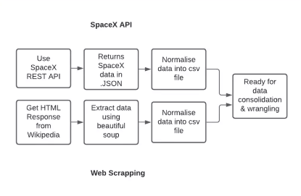
Data Collection
The following dataset was collected;
SpaceX launch data that is gathered from the SpaceX REST API.
This API will give us data about launches, including information about the rocket used, payload delivered, launch specification, landing specification, and landing outcome.
The SpaceX REST API endpoints, or URL, starts with api.spacexdata.com/v4/.
Another popular data source for obtaining Falcom 9 Launch data is web scraping Wikipedia using BeautifulSoup.

Slide 8
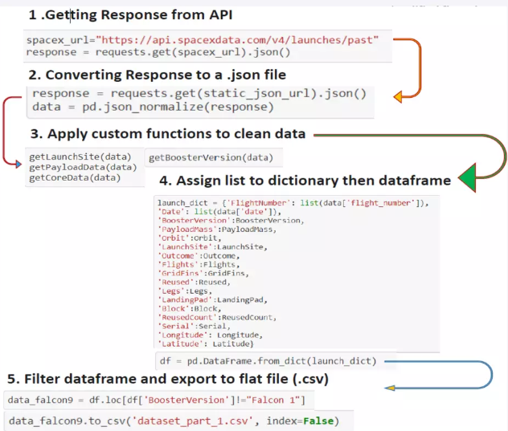
Data Collection – SpaceX API
Data collection SpaceX REST calls
https://github.com/sk3271/IBM-data-science-final-project/blob/main/jupyter-labs-spacex-data-collection-api.ipynb

Slide 9
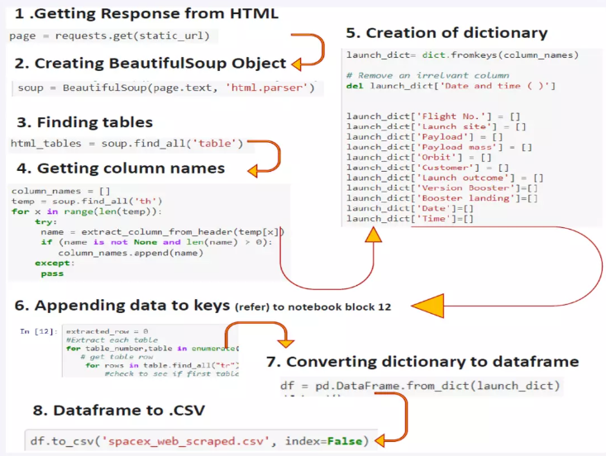
Data Collection - Scraping
Web scraping from wikipeida
https://github.com/sk3271/IBM-data-science-final-project/blob/main/jupyter-labs-webscraping.ipynb
Place your flowchart of web scraping here

Slide 10
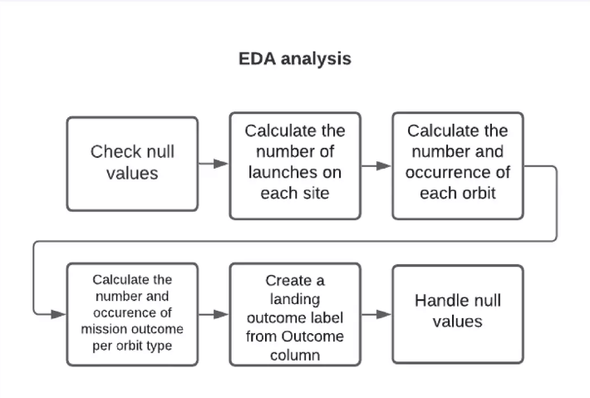
Data Wrangling
https://github.com/sk3271/IBM-data-science-final-project/blob/main/labs-jupyter-spacex-Data%20wrangling.ipynb

Slide 11
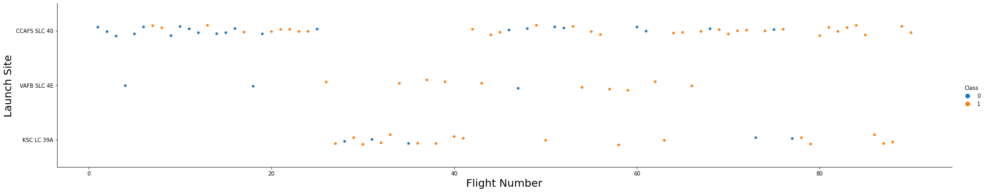
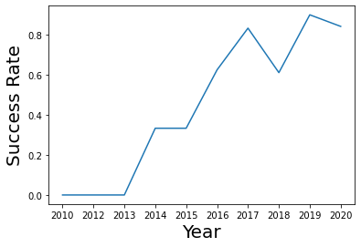
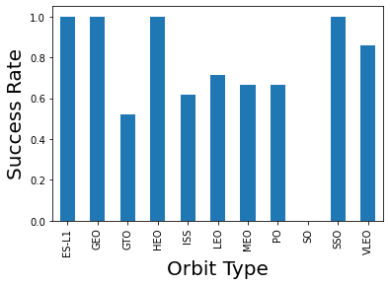
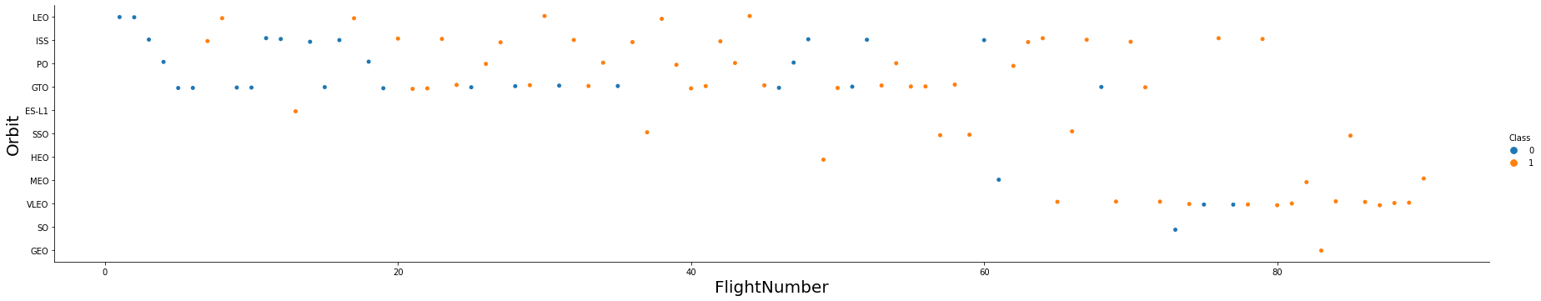
EDA with Data Visualization
https://github.com/sk3271/IBM-data-science-final-project/blob/main/jupyter-labs-eda-dataviz.ipynb

Slide 12
EDA with SQL
Display the names of the unique launch sites in the space mission.
Display 5 records where launch sites begin with the string 'CCA
Display the total payload mass carried by boosters launched by NASA (CRS)
Display average payload mass carried by booster version F9 v1.1
List the date when the first successful landing outcome in ground pad was acheived.
List the names of the boosters which have success in drone ship and have payload mass greater than 4000 but less than 6000
List the total number of successful and failure mission outcomes
List the names of the booster_versions which have carried the maximum payload mass. Use a subquery
List the failed landing_outcomes in drone ship, their booster versions, and launch site names for in year 2015
Rank the count of landing outcomes (such as Failure (drone ship) or Success (ground pad)) between the date 2010-06-04 and 2017-03-20, in descending order

Slide 13
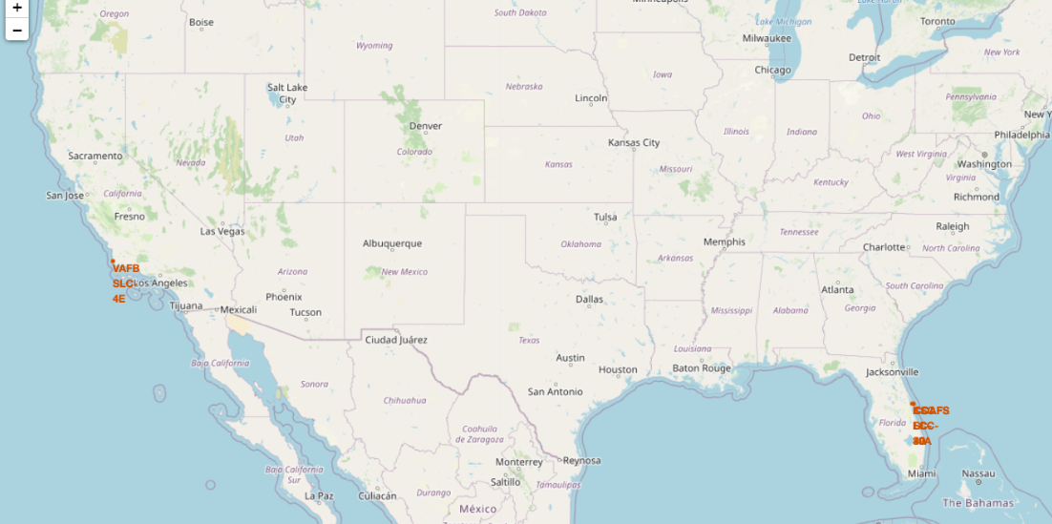
Build an Interactive Map with Folium

Slide 14
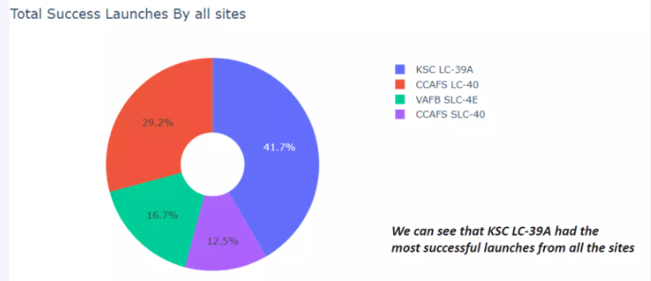
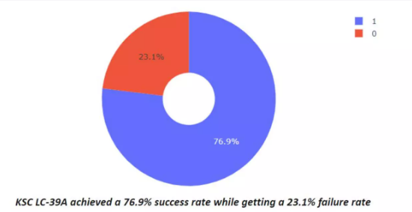
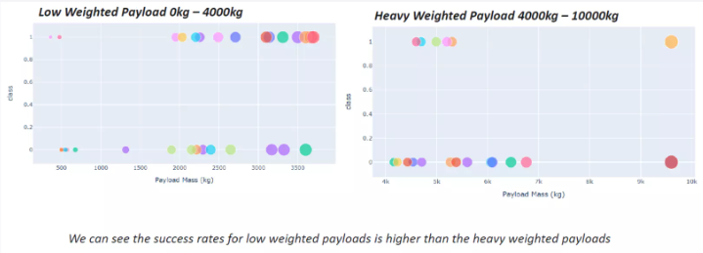
Build a Dashboard with Plotly Dash

Slide 15
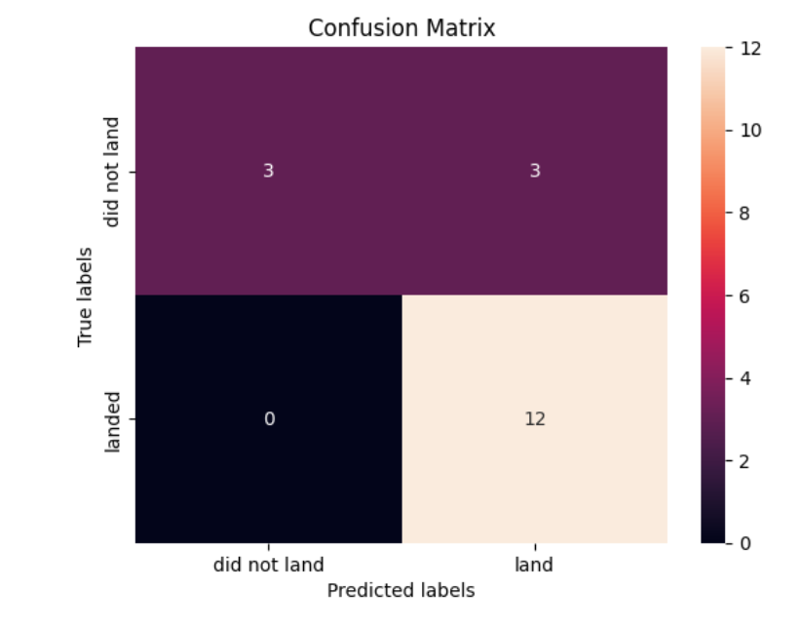
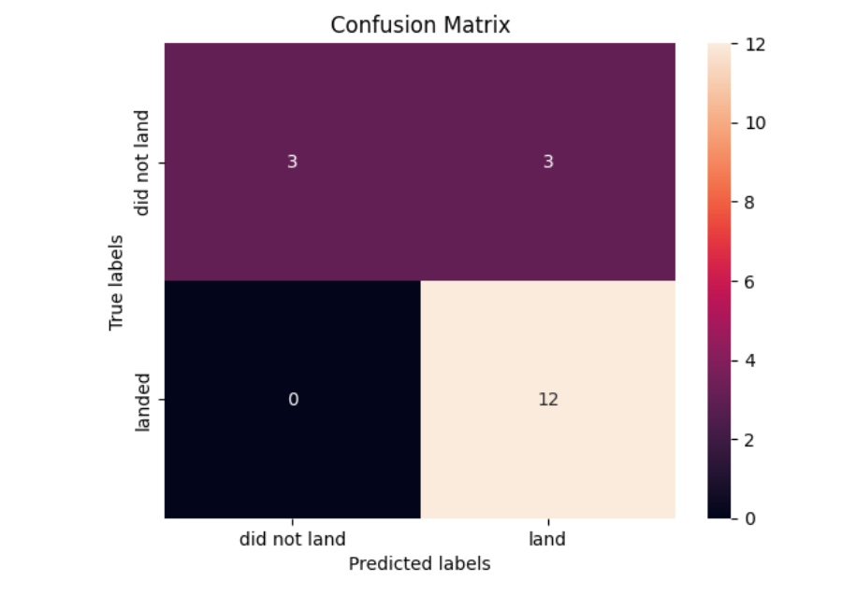
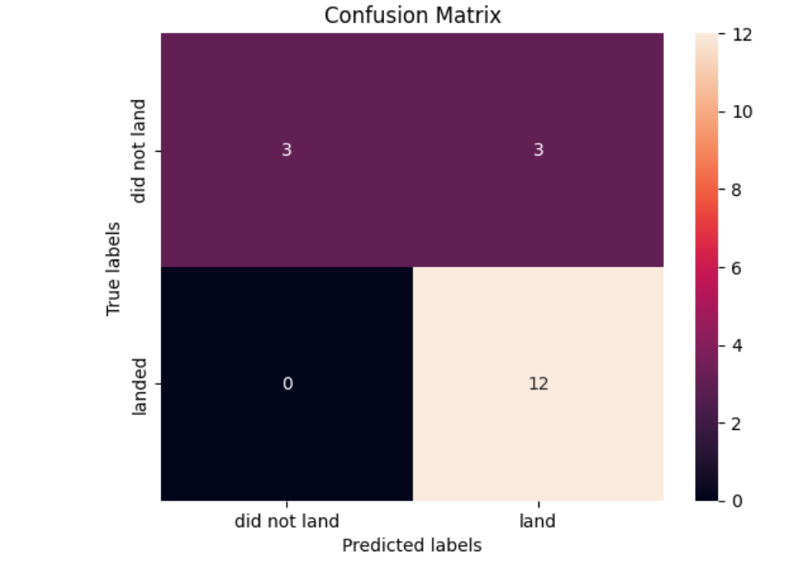
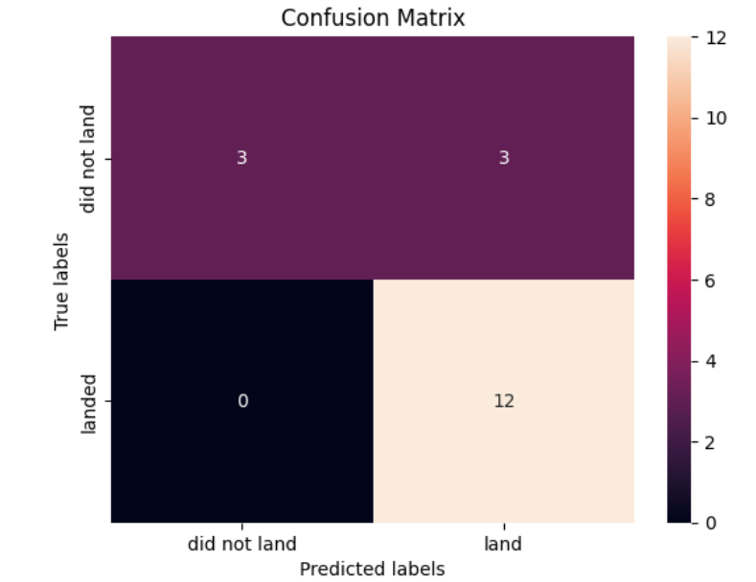
Predictive Analysis (Classification)
https://github.com/sk3271/IBM-data-science-final-project/blob/main/SpaceX_Machine%20Learning%20Prediction_Part_5.ipynb

Slide 16
Results
The SVM, KNN, and logistic regression models are the best in term of prediction accuracy for this dataset.
The success rates for SpaceX launches is directly proportional time in years they will eventually perfect the launches.

Slide 17

Section 2

Slide 18
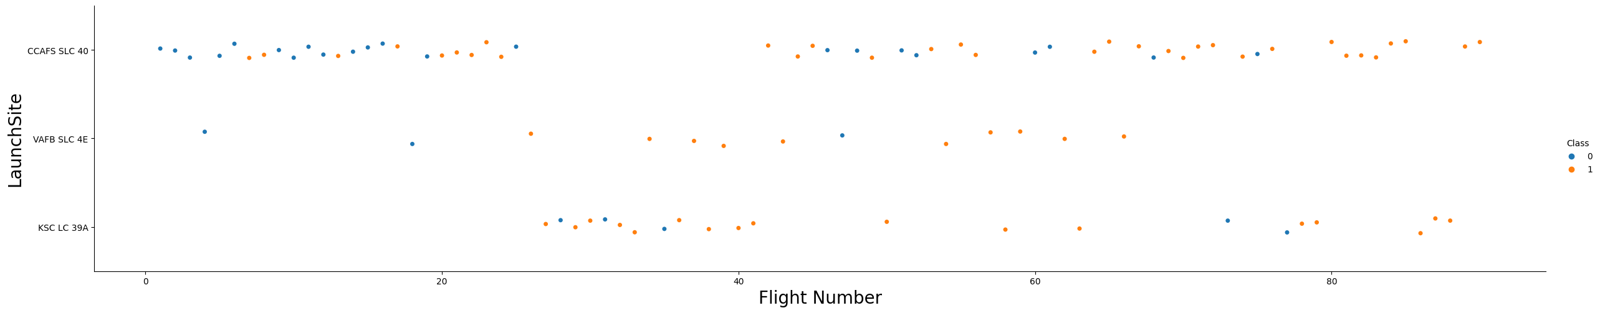
Flight Number vs. Launch Site
CCAFS SLC 40
Launches from the CCAFS SLC 40 are significantly higher than launches from other sites.

Slide 19
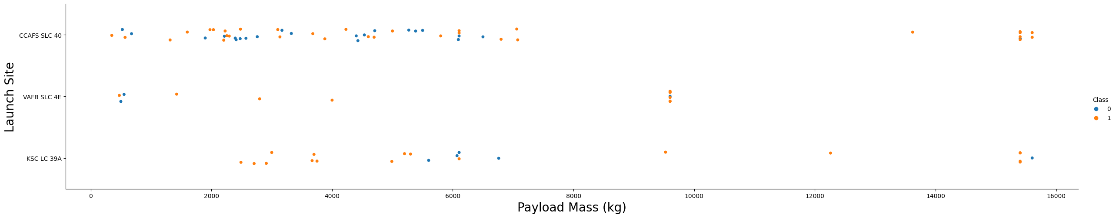
Payload vs. Launch Site
The majority of Ipay Loads with lower Mass have been launched from CCAFS SLC 40.

Slide 20
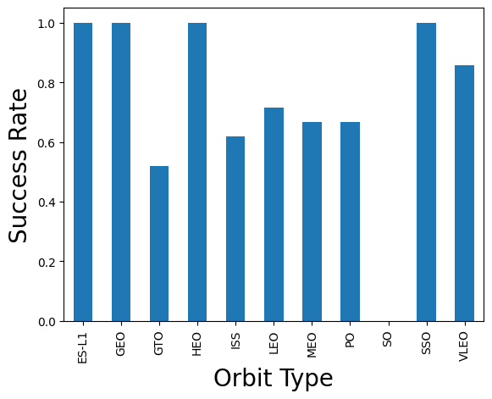
Success Rate vs. Orbit Type
The orbit of ES-L1, GEO, HEO, SSO are among the highest success rate.

Slide 21
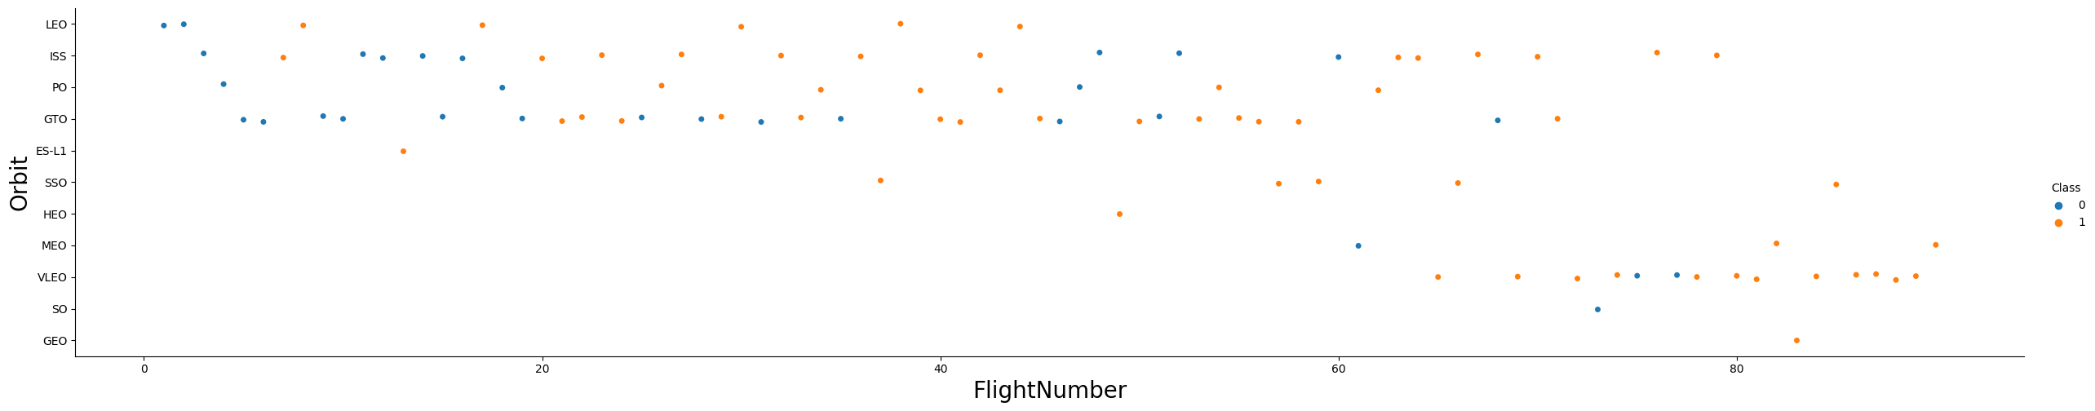
Flight Number vs. Orbit Type
A trend can be observed of shifting to VLEO launches in recent years.

Slide 22
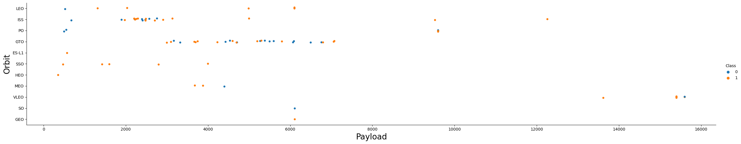
Payload vs. Orbit Type
There are strong correlation between ISS and payload at the range around 2000, as well as between GTO and the range of 4000-8000.

Slide 23
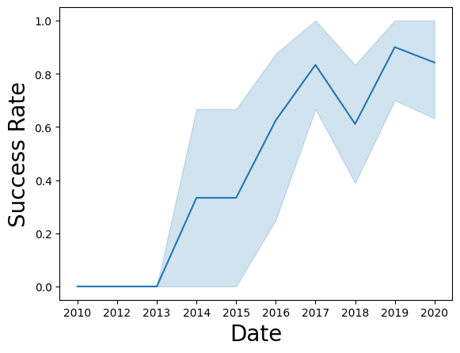
Launch Success Yearly Trend
Launch success rate has increased significantly since 2013 and has stablised since 2019 potentially due to advance in technology and lessons learned.

Slide 24
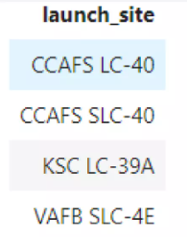
All Launch Site Names
%sql select distinct(LAUNCH_SITE) from SPACEXBL

Slide 25
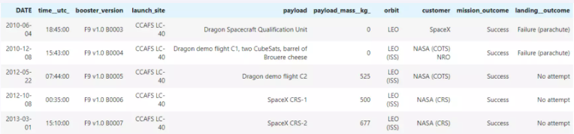
Launch Site Names Begin with 'CCA'
%sql select * from SPACEXBL where LAUNCHSITE_SITE like CCA% limit 5

Slide 26
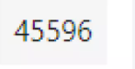
Total Payload Mass
%sql SELECT SUM(PAYLOAD_MASS__KG_) FROM SPACEXTBL WHERE Customer = 'NASA (CRS)';

Slide 27
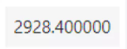
Average Payload Mass by F9 v1.1
%%sql SELECT AVG(PAYLOAD_MASS__KG_) FROM SPACEXTBL WHERE Booster_Version LIKE 'F9 v1.0%';

Slide 28
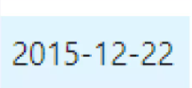
First Successful Ground Landing Date
%%sql SELECT MIN(Date) FROM SPACEXTBL WHERE Landing__Outcome = 'Success (ground pad)';

Slide 29
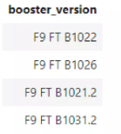
Successful Drone Ship Landing with Payload between 4000 and 6000
%%sql SELECT BOOSTER_VERSION FROM SPACEXTBL WHERE LANDING__OUTCOME = 'Success (drone ship)’ AND 4000 < PAYLOAD_MASS__KG_ < 6000;

Slide 30
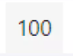
Total Number of Successful and Failure Mission Outcomes
%%sql SELECT MISSION_OUTCOME, COUNT(MISSION_OUTCOME) AS TOTAL_NUMBER FROM SPACEXTBL GROUP BY MISSION_OUTCOME;

Slide 31
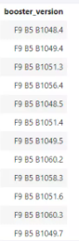
Boosters Carried Maximum Payload
%%sql SELECT DISTINCT BOOSTER_VERSION FROM SPACEXTBL WHERE PAYLOAD_MASS__KG_ = (SELECT MAX(PAYLOAD_MASS__KG_) FROM SPACEXTBL);

Slide 32
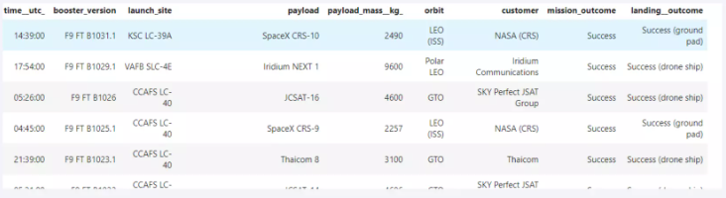
2015 Launch Records
%%sql SELECT LANDING__OUTCOME, BOOSTER_VERSION, LAUNCH_SITE FROM SPACEXTBL WHERE Landing__Outcome = 'Failure (drone ship)’ AND YEAR(DATE) = 2015;

Slide 33
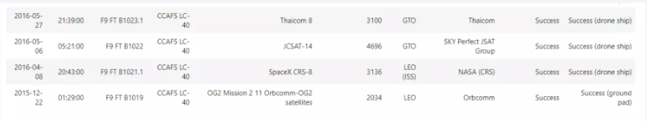
Rank Landing Outcomes Between 2010-06-04 and 2017-03-20
%%sql SELECT LANDING__OUTCOME, COUNT(LANDING__OUTCOME) AS TOTAL_NUMBER FROM SPACEXTBL WHERE DATE BETWEEN '2010-06-04' AND '2017-03-20’ GROUP BY LANDING__OUTCOME ORDER BY TOTAL_NUMBER DESC

Slide 34

Section 3

Slide 35
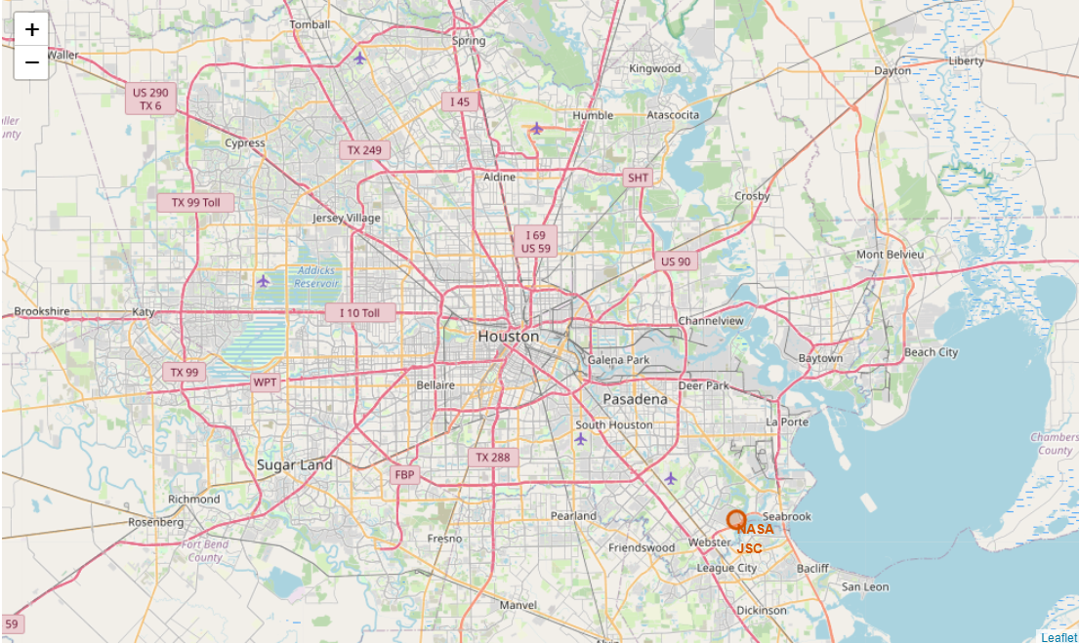
All launch sites marked on a map

Slide 36
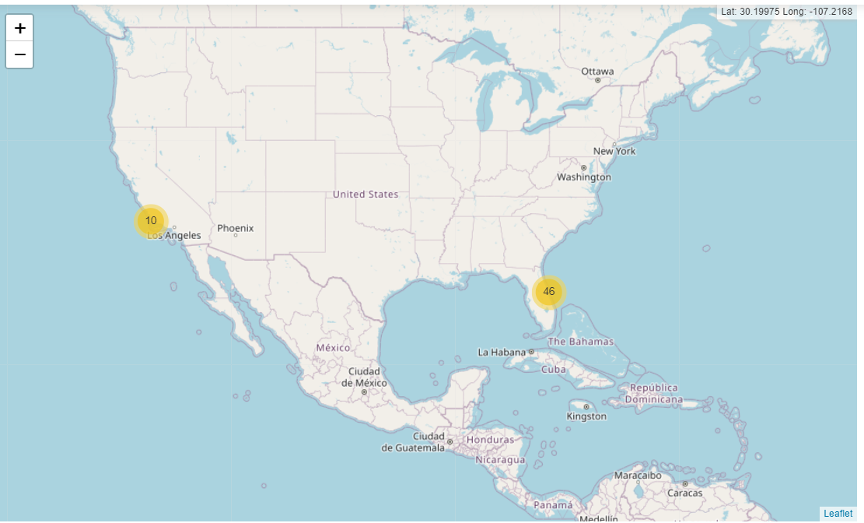

Slide 37
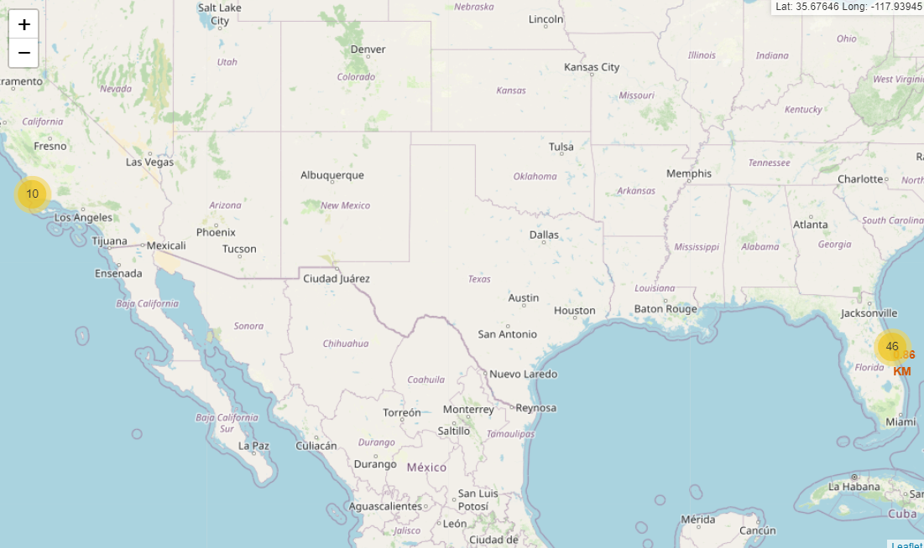

Slide 38

Section 4

Slide 39

Total success launches by all sites

Slide 40

Success rate by site

Slide 41

Payload vs Launch outcome

Slide 42

Section 5

Slide 43
Classification Accuracy
Visualize the built model accuracy for all built classification models, in a bar chart
Find which model has the highest classification accuracy

Slide 44

Confusion Matrix

Slide 45
Conclusions
The SVM, KNN, and logistic regression models are the best in terms of prediction accuracy for this dataset.
Low weighted payloads perfrm better than the heavier payloads
The success rates for spacex launches is directly proportional time in years they will eventually perfect the launches.
KSC LC 39A had the most successful launches from all the sites.
Orbit GEO,HEO, SSO, ESL1 has the best Success Rate.

Slide 46


